Slide 1
Functions with Parameters #2
A supplemental lesson for AP CSP

Slide 2
Warm-up
Review what you already know about parameters and arguments.

Slide 3
When to use a parameter
Here are some basic rules when your function needs a parameter:
Variable needed as an argument Like sleep(delay) or pixels.set(1, color)
If a variable is used to calculate something It is on the right side of an equation (=) >> scale = number / 10
If a variable is used in a condition If statement or loop >> if count < last >> while count < last

Slide 4
A function is procedural abstraction
Procedural Abstraction:
Makes a section of code adaptable
Manages complexity
In the last lesson you added parameters to two programs:
Pixels1_RGB
Billboard1_functions
In this lesson, you will add parameters to three more programs.

Slide 5
Example 3: Answer_Bot
In CodeSpace, open your Answer_Bot program in CodeSpace.
Go to File → Save As… and rename the file Answer_Bot_parameters
This program has one function.
Move the sleep(0.1) statement from the main program to the function.
Add a parameter for delay, and use it in the sleep() function.

Slide 6
Example 3: Answer_Bot
Make this program a little more interesting by changing the delay each time the function is called.
Get a random number between 1 and 10 for delay. You want a value less than 1.0, so divide the number by 10.
Use the number as the argument in the function call.

Slide 7
What data types can be used for a parameter?
In Example #1 Pixels1, you had two types of parameters:
A pre-defined color (like RED)
An integer (for brightness and delay)
In Example #2 Billboard_functions, you had one parameter:
An integer for choice
In example #3: Answer_Bot, you had one parameter:
A float (decimal) for delay
Can you use something other than a color and a number?

Slide 8
What data types can be used for a parameter?
YES! Any data type can be used as a parameter:
Pre-defined color
Integer
Float
Boolean
String (“anything in quotes”)
Pre-defined image (pics)
A CodeX button
Let’s look at a couple more examples that use different data types for parameters.

Slide 9
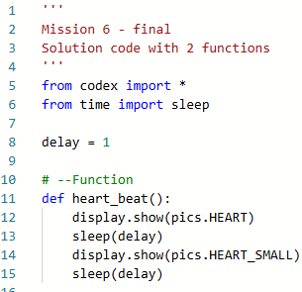
Example 4: Heart2_functions
In CodeSpace, open the program Heart2_functions in the sandbox.
Go to File → Save As… and rename the file Heart2_parameters
The heart_beat() function doesn’t have a parameter.
But it does flip between two images.
Right now the images are always a heart and a small heart.

Slide 10
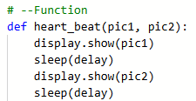
Example 4: Heart2_functions
Add two parameters: one for each image.
Use the parameters in the function.

Slide 11
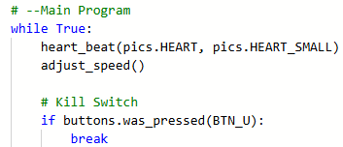
Example 4: Heart2_functions
Call the function using two arguments for the images.
Run the code.

Slide 12
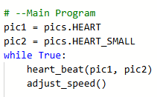
Example 4: Heart2_functions
The program works great, but why have parameters if it is going to do the same thing every time?
Let’s make it more interesting by letting the user choose which images to animate.
First, use variables for the arguments.
Add two global variables in the main program for pic1 and pic2.

Slide 13
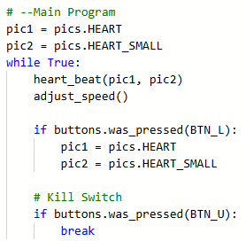
Example 4: Heart2_functions
Use if statements for button presses to change the value of pic1 and pic2.
An example for one button is shown →
Add two more button presses for two more animations to your code. BTN_R and BTN_D

Slide 14
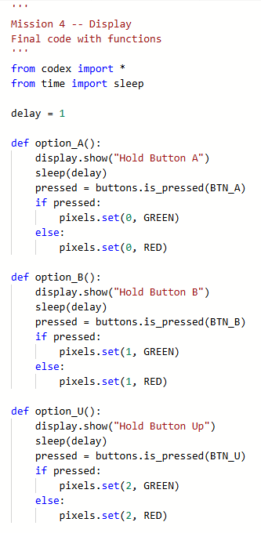
Example 5: Display_functions
A bitmap image works as a parameter. Let’s try a string and a button as parameters.
In CodeSpace, open the program Display_functions program in the sandbox.
Go to File → Save As… and rename the file Display_parameters
The program has four functions. They all do the same thing, just with a different button.
Let’s combine the four functions into one function, with parameters.

Slide 15
Example 5: Display_functions
First, let’s look at the functions and point out what is different with each one.
The display.show() prints a different button to press on the screen.
The argument for buttons.is_pressed() is different.
The pixel to light is different.
Each difference can be a parameter, or the functionality can be changed.

Slide 16
Example 5: Display_functions
Let’s change the functionality of the code for the pixels.
The current code lights only one pixel at a time, and it limits the game to only four tries.
Let’s change the code to light up all the pixels RED or GREEN, so you can have as many button presses as you want.

Slide 17
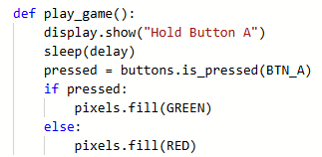
Example 5: Display_functions
Change the name of option_A() to play_game()
Change the pixels.set() to pixels.fill()

Slide 18
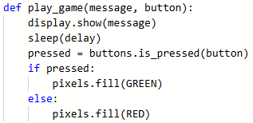
Example 5: Display_functions
Use parameters for the message in display.show() and the button press.
Delete the other three functions.
You are ready to call the one function and create a game.

Slide 19
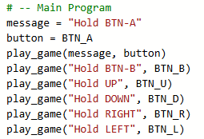
Example 5: Display_functions
For each button press, call the play_game() function with two arguments: the message and the button.
You can use variables for the arguments, or literal values.
An example of each is given below.
Best of all, you get to determine the order, and the number, of button presses in your game.
Example using variable for arguments.
Examples using literal values for arguments.

Slide 20
When to use a local variable
Here are some basic rules when your function needs a local variable:
If the variable is being calculated It is on the left side of an equation (=) red = random.randrange(256) color = (red, green, blue) scale = number / 10
If the variable is the loop control variable count = 0 while count < last: count = count + 1

Slide 21
Local Variables
Let’s review local variables.
A local variable is defined and used only within a function.
Look at Example 3 Answer_Bot
Identify the parameters and their data types.
Identify the local variables and their data types.
Write your answers on your Activity Guide.

Slide 22
Local Variables
Look at Example 4 Heart2_functions
Identify the parameters and their data types.
Identify the local variables and their data types.
Write your answers on your Activity Guide.

Slide 23
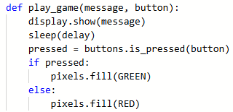
Local Variables
Look at Example 5 Display_functions.
Identify the parameters and their data types.
Identify the local variables and their data types.
Write your answers on your Activity Guide.

